Slide 1
ELEC462 SYSTEM PROGRAMMING - PROJECT FINAL PRESENTATION
Rhythm Game - RasLab
By
Young Ha
KyuMin Hwang
TaeWon Kim
DongJin Kim

Slide 2
TEAM MEMBERS
TOPIC
DESIGN
IMPLEMENTATION
DEMO
EXTRA & DETAIL
CONTENTS

Slide 3
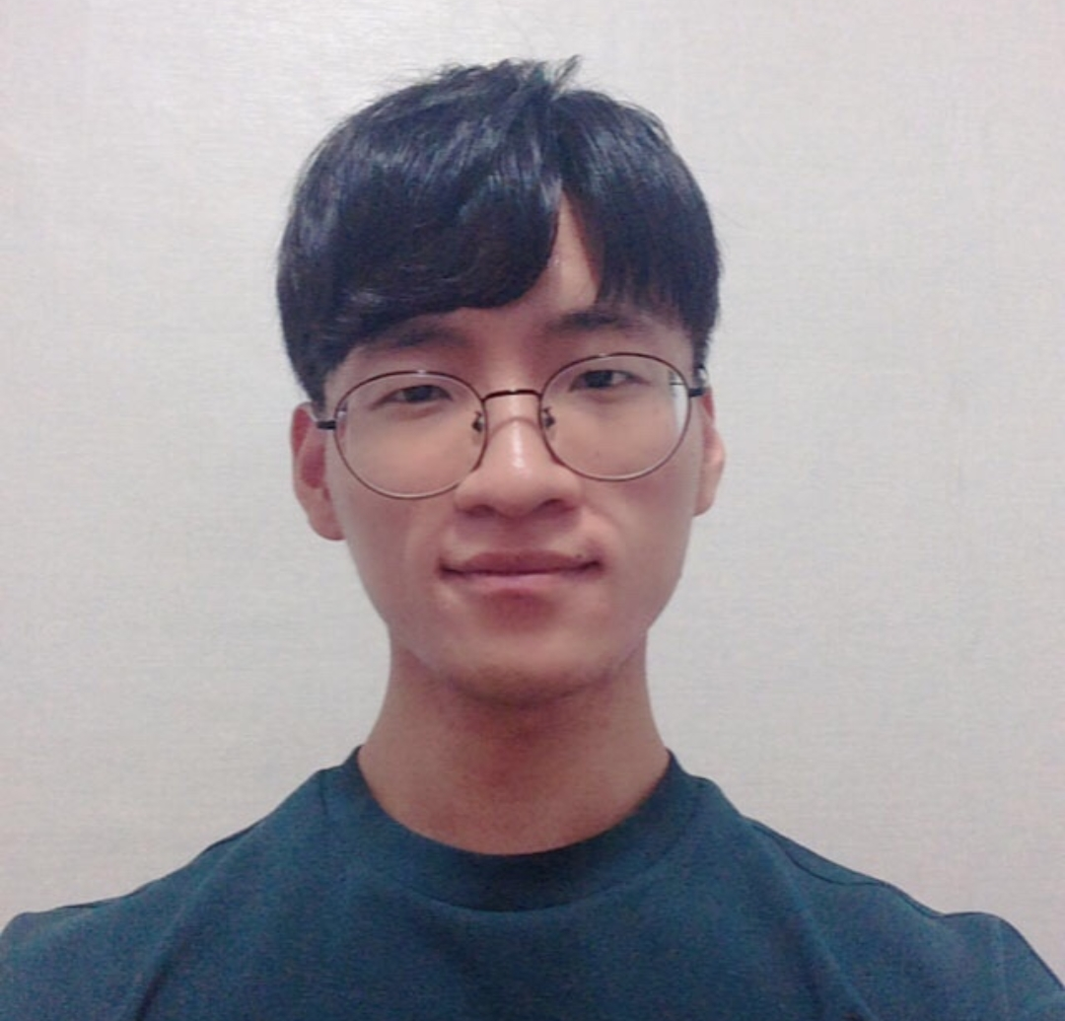
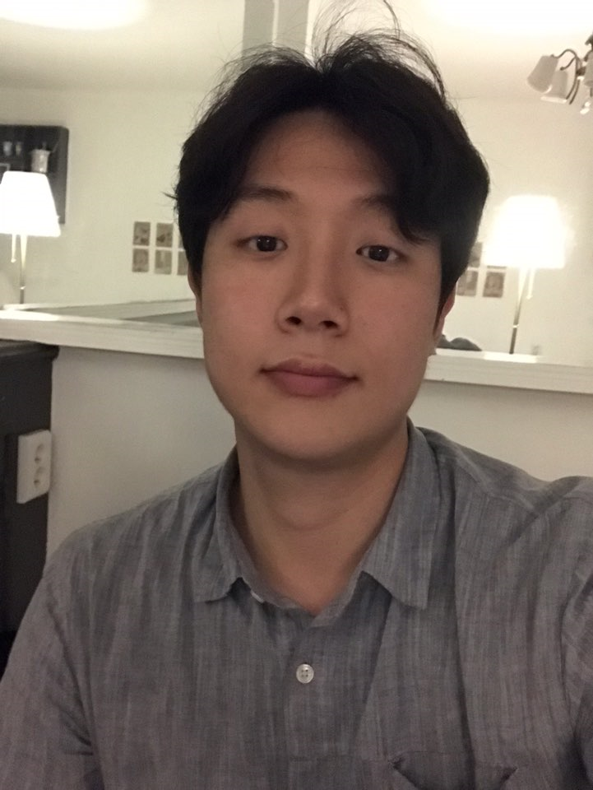
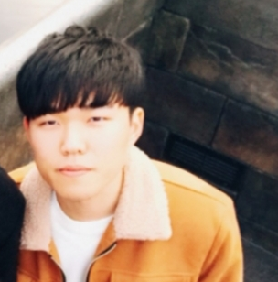
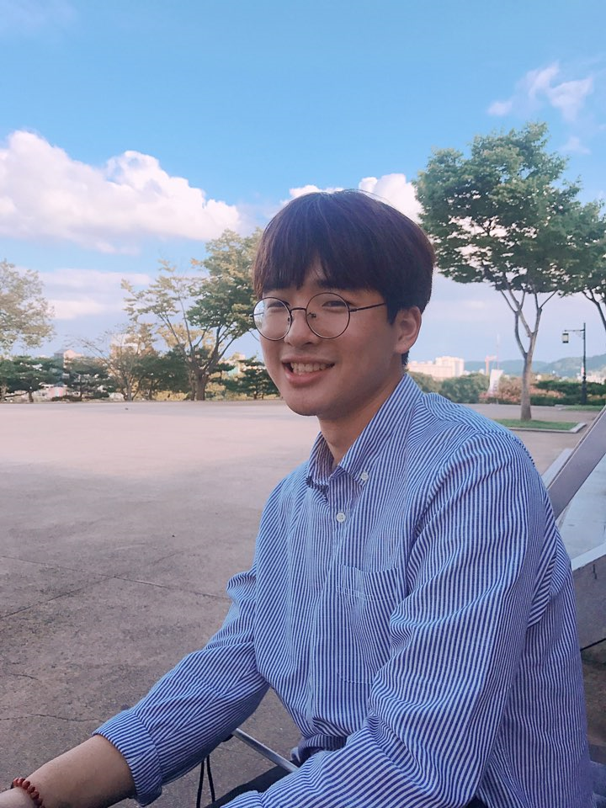
TEAM MEMBERS
Young Ha Team member
Product Manager
KyuMin Hwang Team member
Git Manager
Developer
TaeWon Kim Team member
Developer
SW Designer
DongJin Kim Team member
HW Manager
HW Designer

Slide 4




TOPIC
< MUSIC >
< GAME >
< EMBEDDED SYSTEM >

Slide 5
3. DESIGN

Slide 6
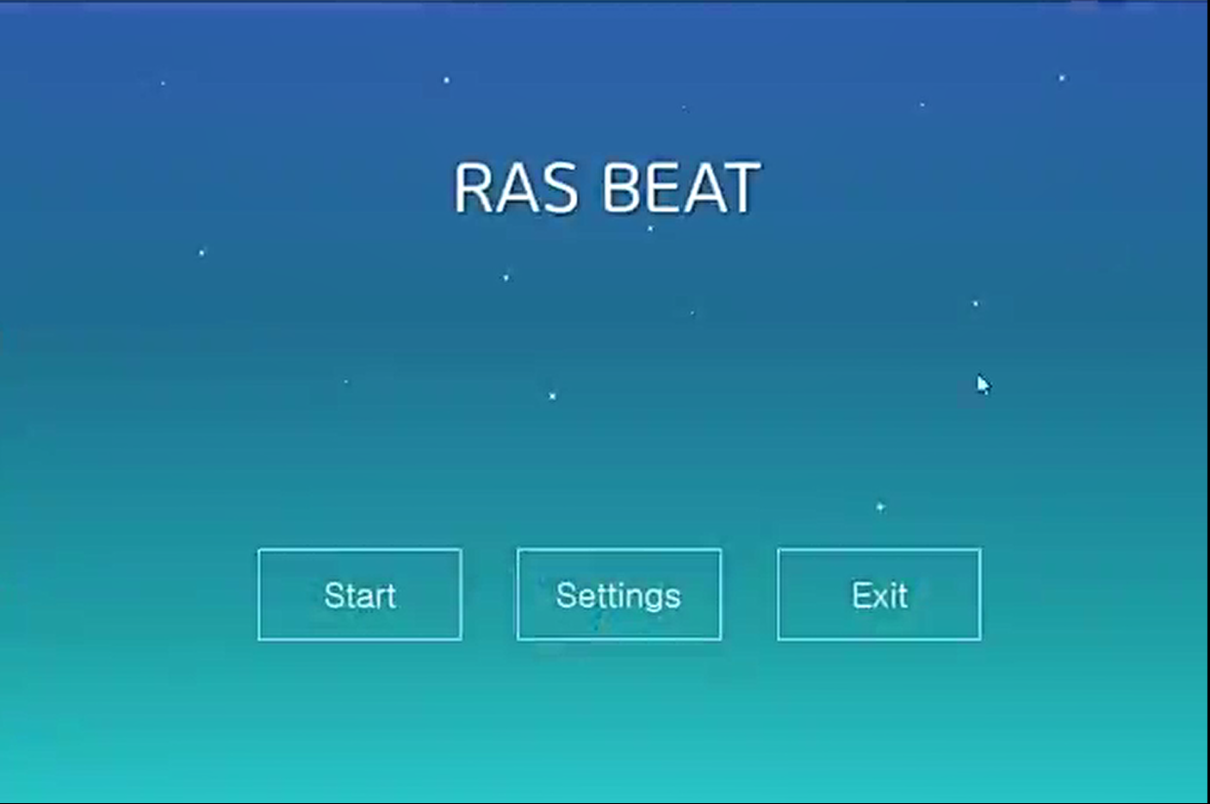
DESIGN
1. Main
Main Screen,
Choose start, setting, exit

Slide 7
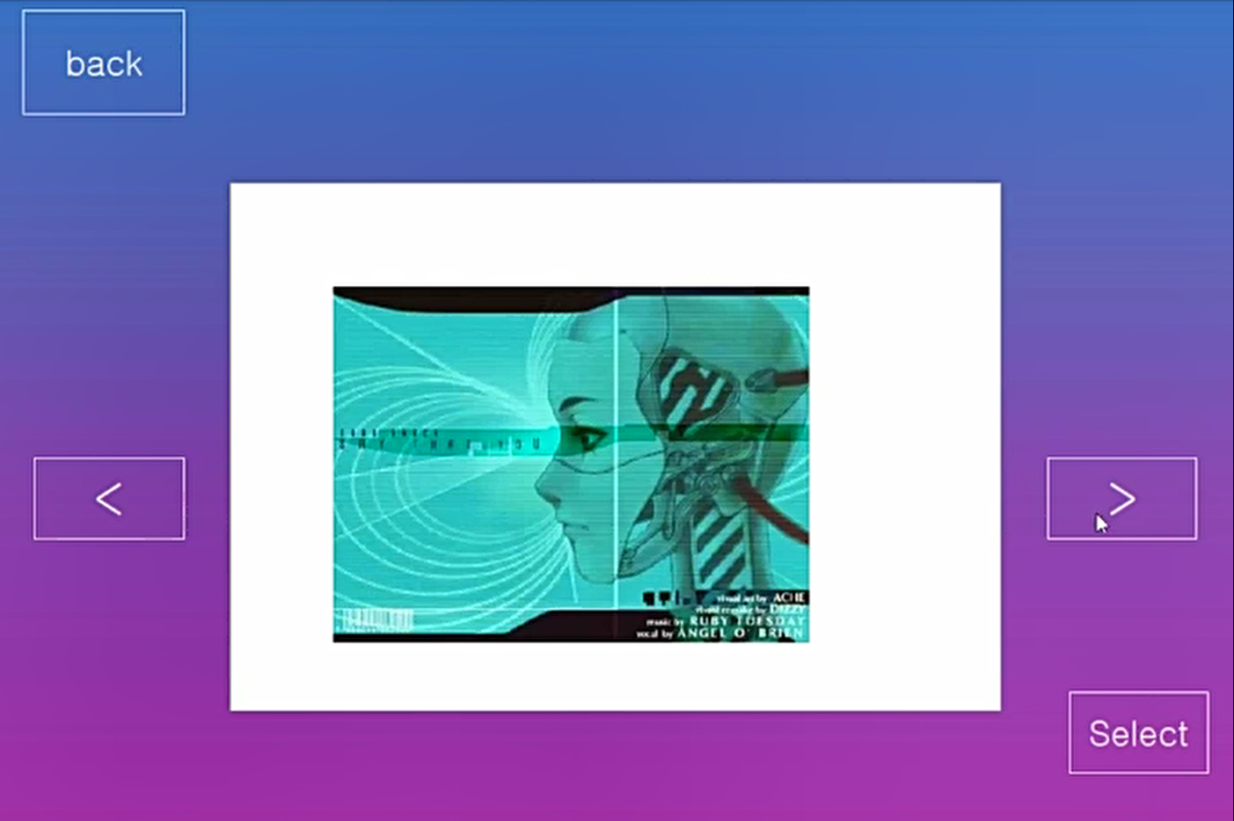
DESIGN
2. Select Music
Push Start
Choose Music

Slide 8
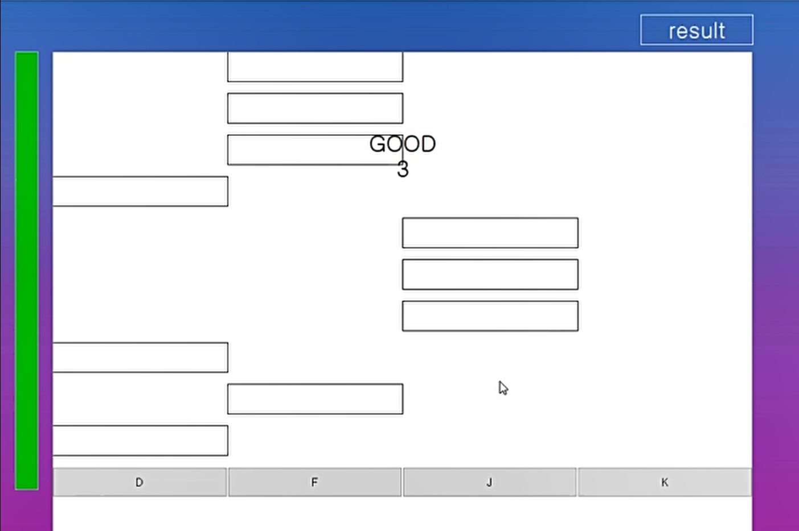
DESIGN
3. In Game
Press button, you can get Score
Perfect, Good, Miss
Additionally, Combo!
If life bar is gone, the game will be over.
“Life bar”

Slide 9
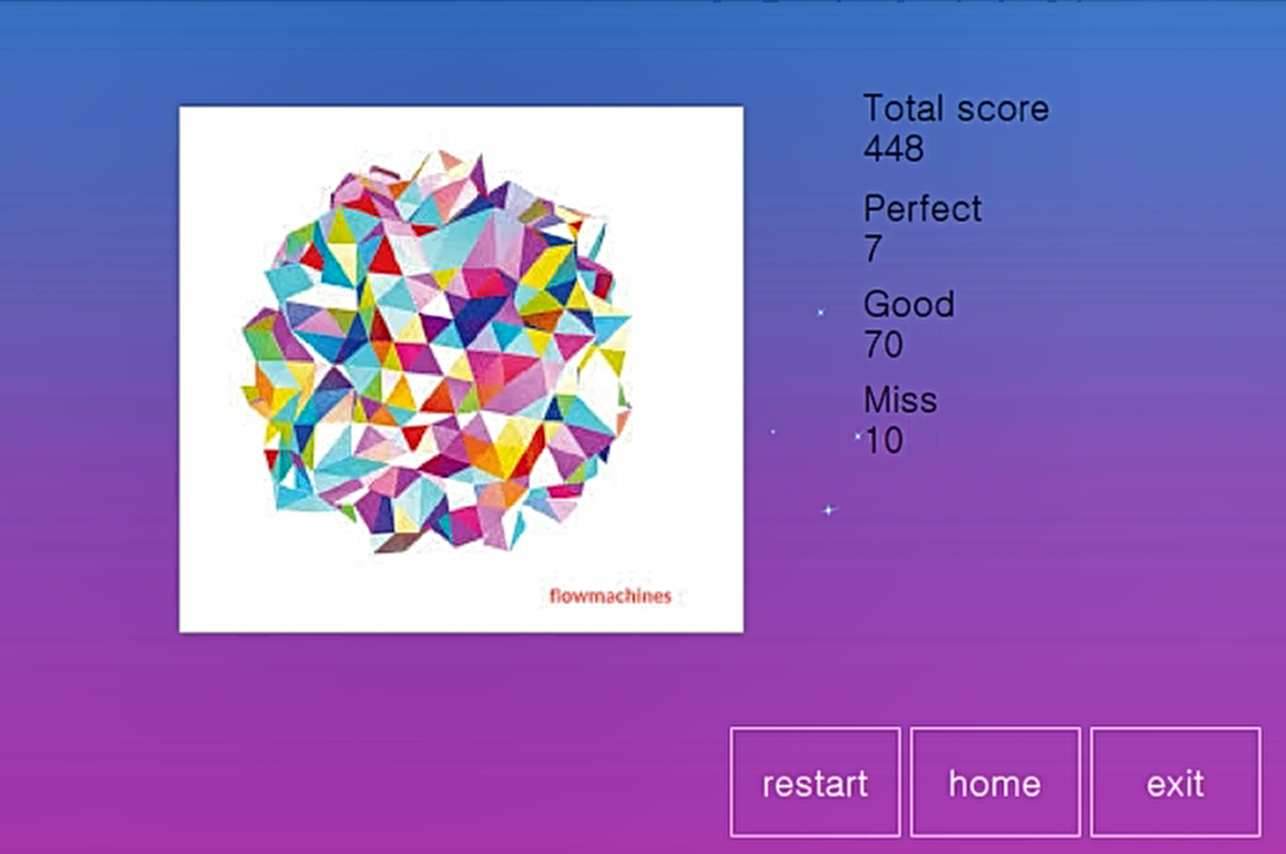
DESIGN
4. Result
You can get your Total Score
And, detail Score

Slide 10
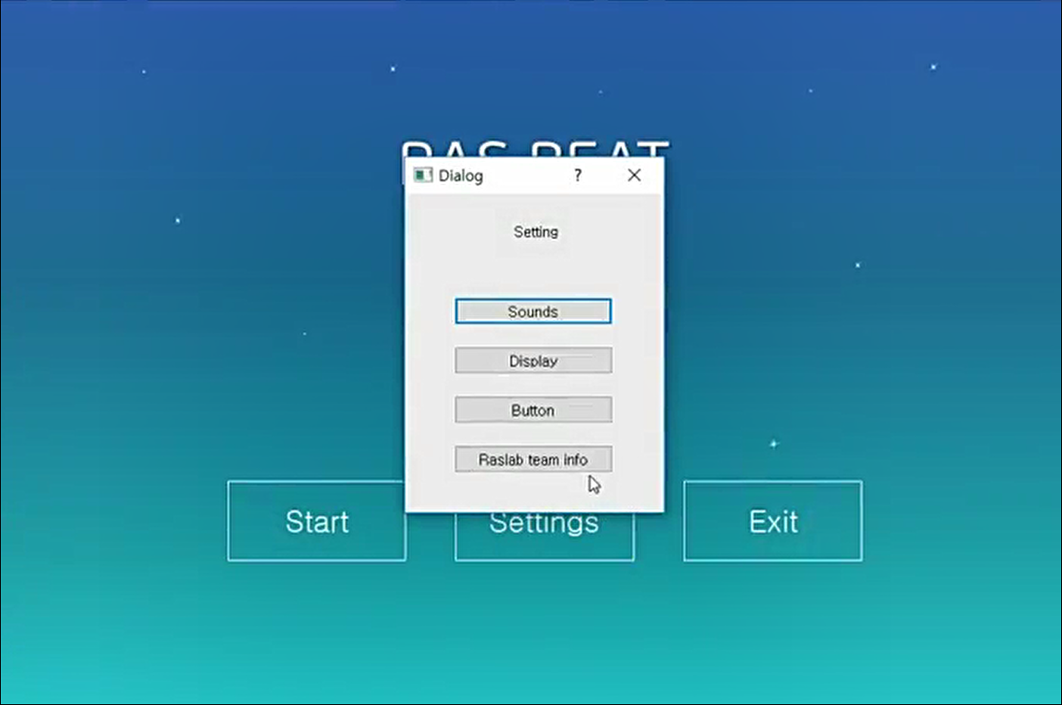
DESIGN
5. Setting
Change Sounds
Change button
Change display size
Team informations

Slide 11
4. IMPLEMENTATION

Slide 12


IMPLEMENTATION
GIT
version control program
Qt, c ++ based program

Slide 13
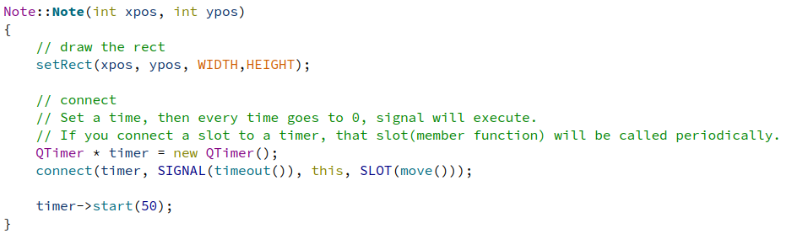
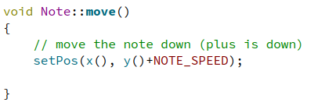
IMPLEMENTATION
1. Note
Constructor use timer and SIGNAL processing

Slide 14
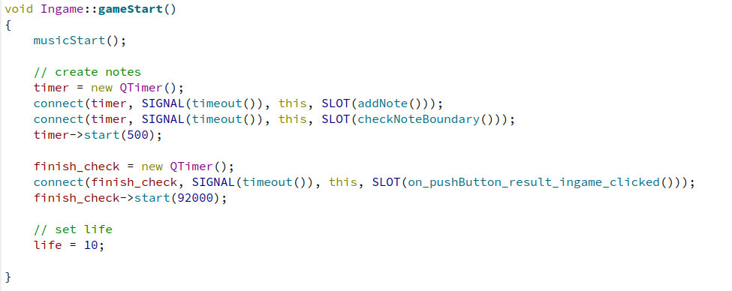
IMPLEMENTATION
2. Game Start
use timer and SIGNAL processing

Slide 15
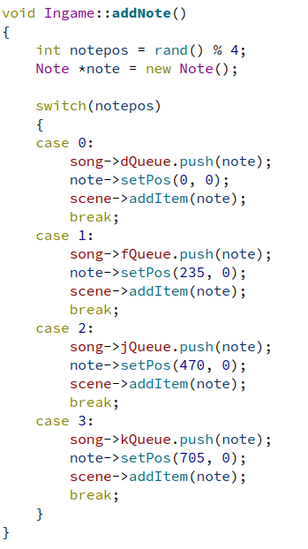
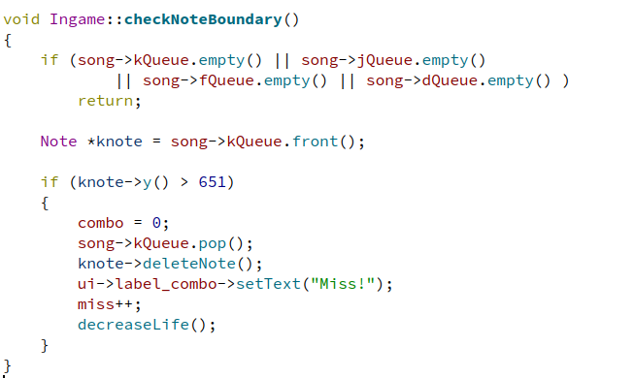
IMPLEMENTATION
3. Add / Delete
notes
4 Queue for each line
Release memory when note go out of range
And decrease Life

Slide 16
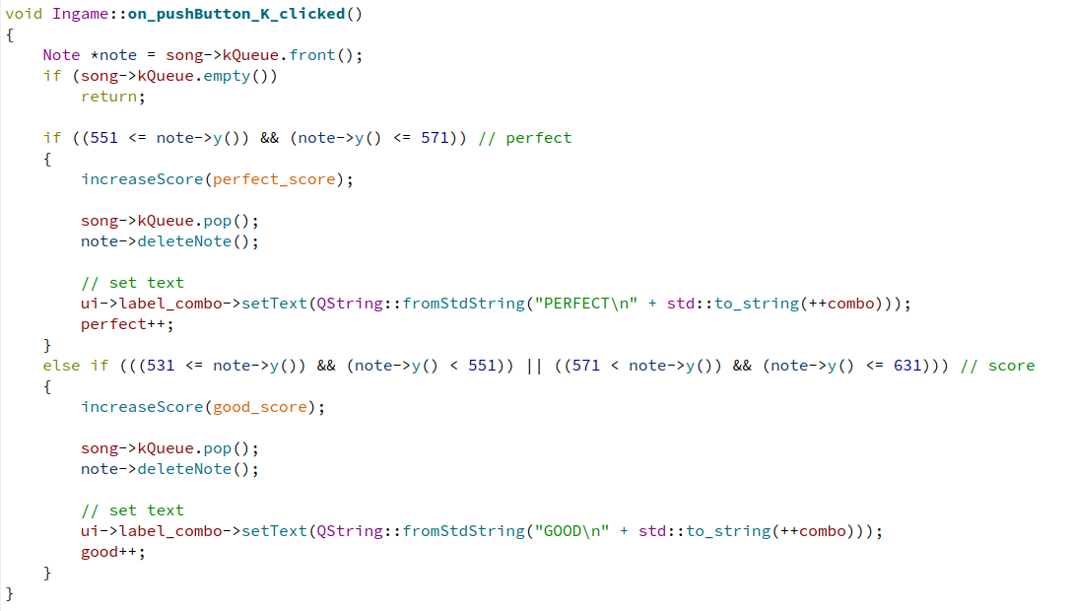
IMPLEMENTATION
4. Key pressed
Check the timing is perfect or just good?
Increase score
Change label to inform user about the score

Slide 17
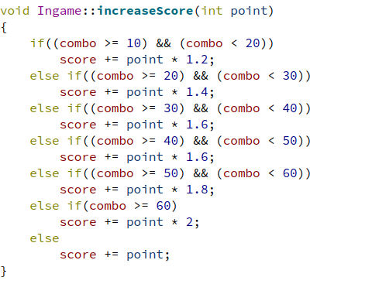
IMPLEMENTATION
5. Get score
It depends on perfect or good
High combo, High score

Slide 18
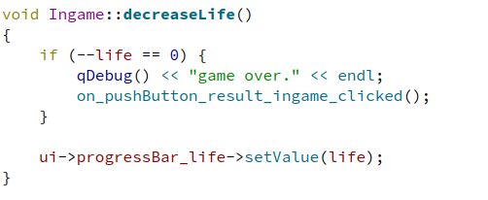
IMPLEMENTATION
6. Miss!
We’ll not decrease your score
But life!
Game over when life == 0 (T^T)

Slide 19
5. DEMO

Slide 20
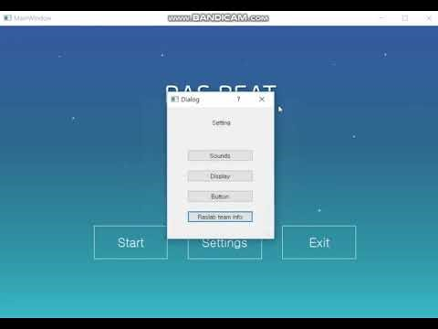
DEMO
Notes:
슬라이드 쇼 도중에 재생할수 있습니다.
혹시 재생 안될수도 있는 경우를 대비해서 https://youtu.be/uPe0djHBfUU 주소 올려드려요

Slide 21
6. EXTRA & DETAIL

Slide 22

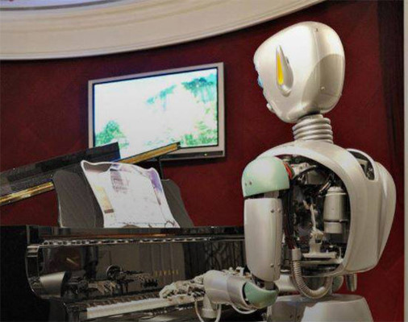
EXTRA & DETAIL
Q : What Song?
A : “Daddy’s Car”
This song is composed by Artificial intelligence
Notes:
Detail part
데모영상에서 소개된 노래에 대한 정보에요, 특징으로 ai가 만들었다 는 사실이고,
이 노래는 beatles스타일로 만들어졌습니다.
프랑스 작곡가 베누아 카르레가 곡을 편곡하고 작곡하고 가사를 썼습니다.

Slide 23



EXTRA & DETAIL
Q : What Qt?
A : 컴퓨터 프로그래밍에서 GUI프로그램 개발에 널리 쓰이는 C++기반의 크로스 플랫폼 프레임워크. 서버용 콘솔과 명령 줄 도구와 같은 비GUI 프로그램 개발에도 사용된다.
Notes:
Qt : (큐트)

Slide 24
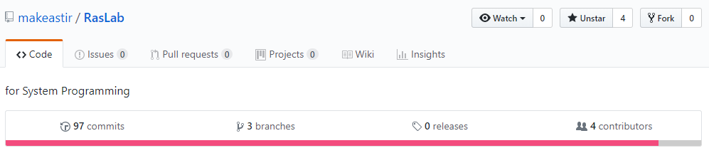
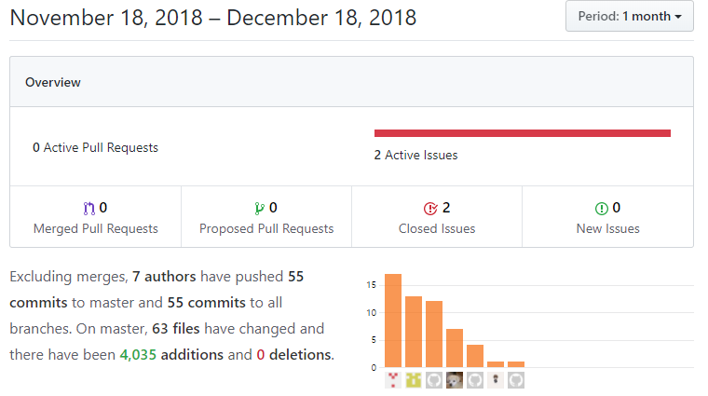
EXTRA & DETAIL
Total Commit : 97
Total Changed : 4015
https://github.com/makeastir/RasLab

Slide 25
Q & A
please don't hesitate to ask me any questions.

Slide 26
THANK YOU !
.

